Slide 1
Project Name: Financial Tracker - An Interactive Web Application
Introduction:
Welcome to the presentation of Financial Tracker, an innovative web application designed to help individuals effectively manage their personal finances.
Managing personal finances is a crucial aspect of achieving financial stability and reaching financial goals.
The purpose of our project is to provide users with a user-friendly and intuitive tool for tracking income and expenses, along with the transaction history ,empowering them to make informed financial decisions.
With Financial Tracker, users can easily monitor their cash flow, edit or delete any transactions and maintain a clear overview of their financial health.
Our web application aims to simplify the often daunting task of managing personal finances, enabling users to take control of their money and work towards their financial objectives.

Slide 2
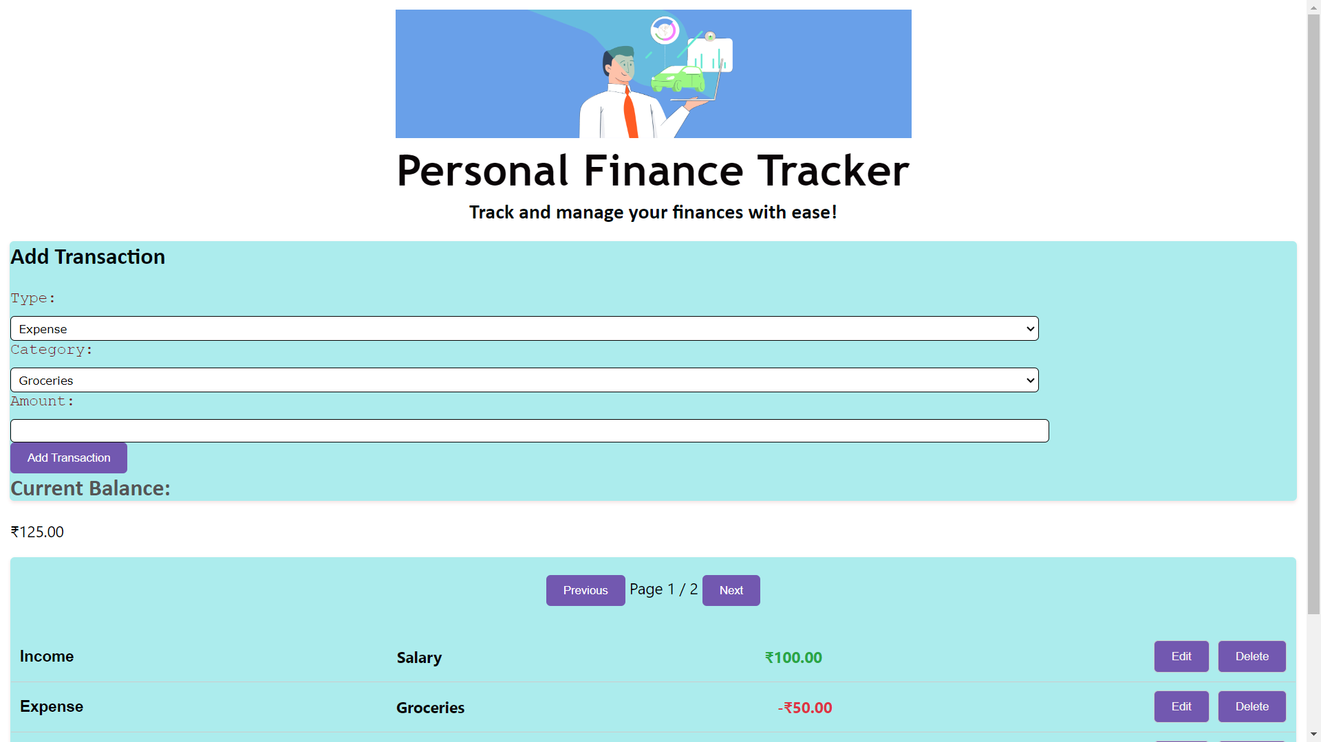

Slide 3
Main Features and Functionality of the Website
Transaction Management:
Add and track income and expenses conveniently.
Categorize transactions for better organization and analysis.
Edit or delete transactions as needed.
Real-time Balance Calculation:
Automatically calculates the balance based on income and expense entries.
Provides an up-to-date snapshot of your financial status.
Helps you make informed financial decisions.
User-Friendly Interface:
Intuitive design for easy navigation and seamless user experience.
Responsive layout, accessible from desktop and mobile devices.
Clear and visually appealing transaction display.

Slide 4
Editing and Deleting Transactions:
Enable inline editing for quick modification of transaction details.
Delete unwanted transactions effortlessly.
Ensure accurate and up-to-date financial records.
Receive feedback messages when a transaction is added, deleted, or edited successfully.
Pagination and Transaction History:
View transactions in a paginated format for easy browsing.
Access transaction history to track past financial activities.
Navigate through pages to accommodate a large number of transactions.

Slide 5
Technologies Used
Front-end Development:
HTML (Hypertext Markup Language)
CSS (Cascading Style Sheets)
JavaScript
Libraries and Frameworks:
Bootstrap: A popular CSS framework for responsive design and layout.
jQuery: A fast and feature-rich JavaScript library for DOM manipulation and event handling.
Back-end Development:
No specific Back-end technology used. The website is purely front-end based.
Database Management:
No database management system used. Transactions are stored in memory.
Other Tools and Technologies:
No additional tools or technologies used.
Note: This website is built using front-end technologies and does not require a back-end or database. The focus is on client-side interactivity and data manipulation.

Slide 6
Adding Transactions
1. User-Friendly Transaction Form:
- The website provides a user-friendly transaction form where users can input their transaction details.
- The form includes the following input fields:
- Type: Users can select the transaction type, either "income" or "expense," from a dropdown menu.
- Category: Based on the selected type, a corresponding set of categories is dynamically populated in another dropdown menu.
- Amount: Users can enter the transaction amount, which is validated for a valid numeric value greater than zero.
- Upon submission of the form, the data is processed to add the transaction to the system.
2. Input Validation:
- The entered amount is validated to ensure it is a valid numeric value greater than zero. If an invalid amount is entered, an alert message is displayed, prompting the user to enter a valid amount.
- The form also includes a check to ensure that a category is selected. If no category is selected, an alert message is displayed, prompting the user to select a category.

Slide 7
3. Storing and Updating Transactions:
- The entered transaction is stored as an object in the system.
- The transaction object consists of the following properties:
- Type: Represents the type of the transaction, either "income" or "expense."
- Category: Represents the category of the transaction selected by the user.
- Amount: Represents the amount of the transaction, with negative values for expenses and positive values for income.
- The new transaction is added to the existing list of transactions, which is stored in the `transactions` array.
- The balance is updated accordingly by adding or subtracting the transaction amount from the total balance.
- After adding the transaction, the system displays a success alert message to notify the user that the transaction was added successfully.

Slide 8
Editing Transactions
How users can edit existing transactions:
Users can edit existing transactions by clicking on the "Edit" button associated with each transaction in the transaction list.
Upon clicking the "Edit" button, the transaction details will transform into editable fields, allowing users to modify the transaction type, category, and amount.
Users can then save the updated transaction by clicking the "Save" button or cancel the editing process by clicking the "Cancel" button.
Inline editing feature and its implementation:
The website incorporates an inline editing feature to provide a seamless and efficient editing experience for users.
When a user clicks the "Edit" button, the transaction details within the respective list item are replaced with editable fields for type, category, and amount.
The inline editing feature is implemented using JavaScript to dynamically update the DOM and enable direct editing of transaction details.

Slide 9
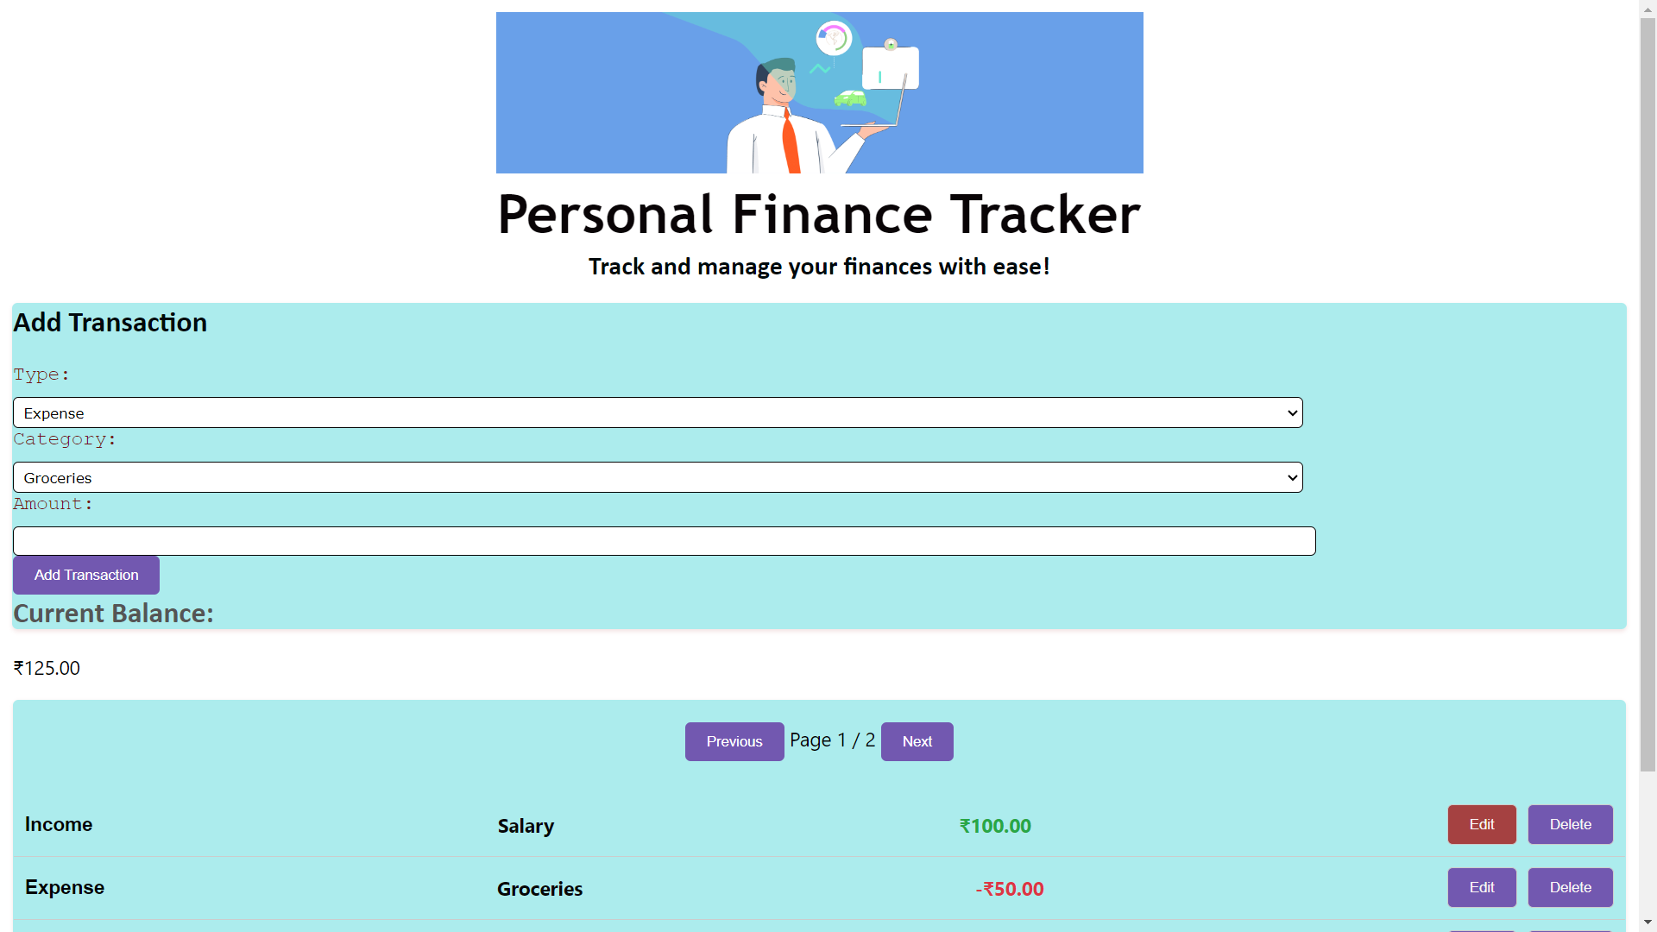

Slide 10
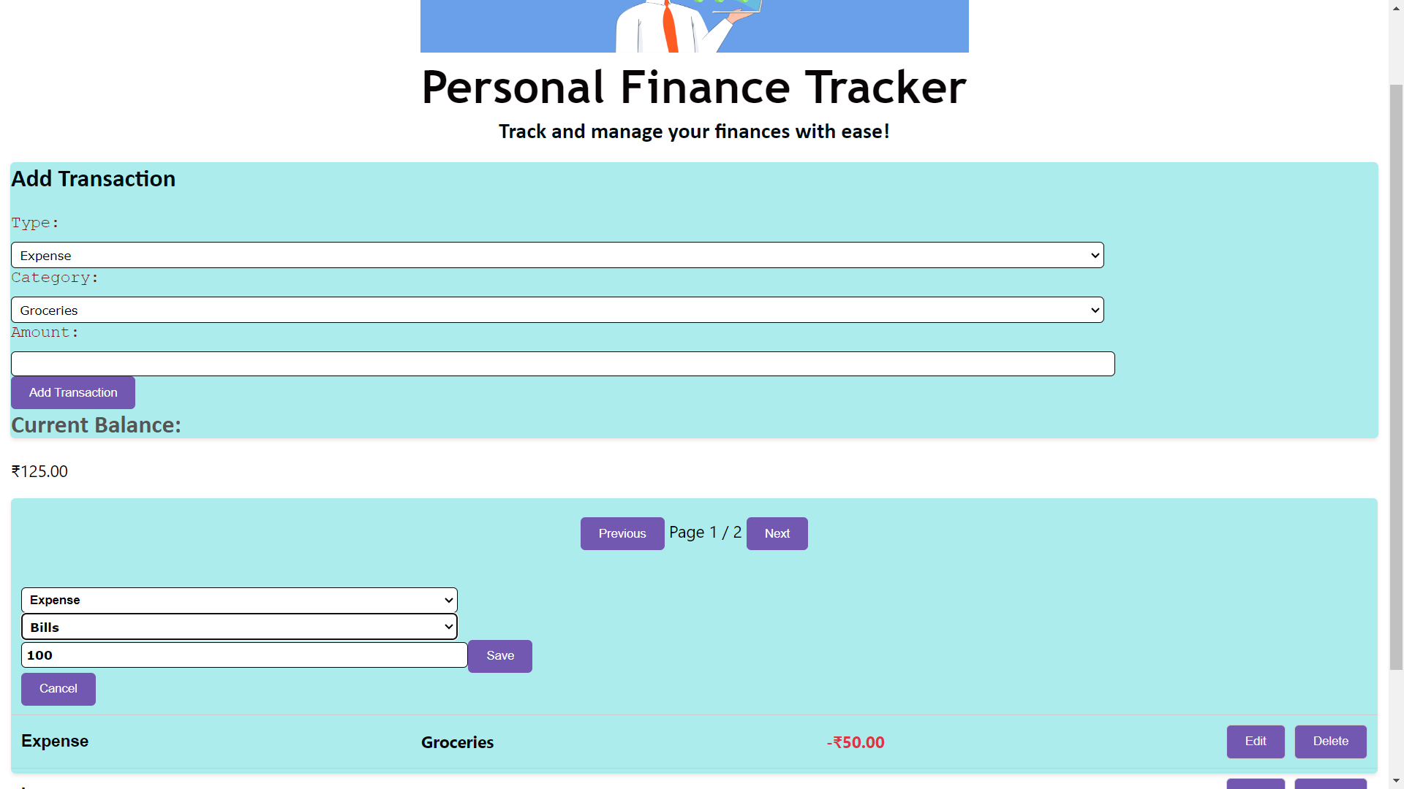
Changed txn details from income to expense.

Slide 11
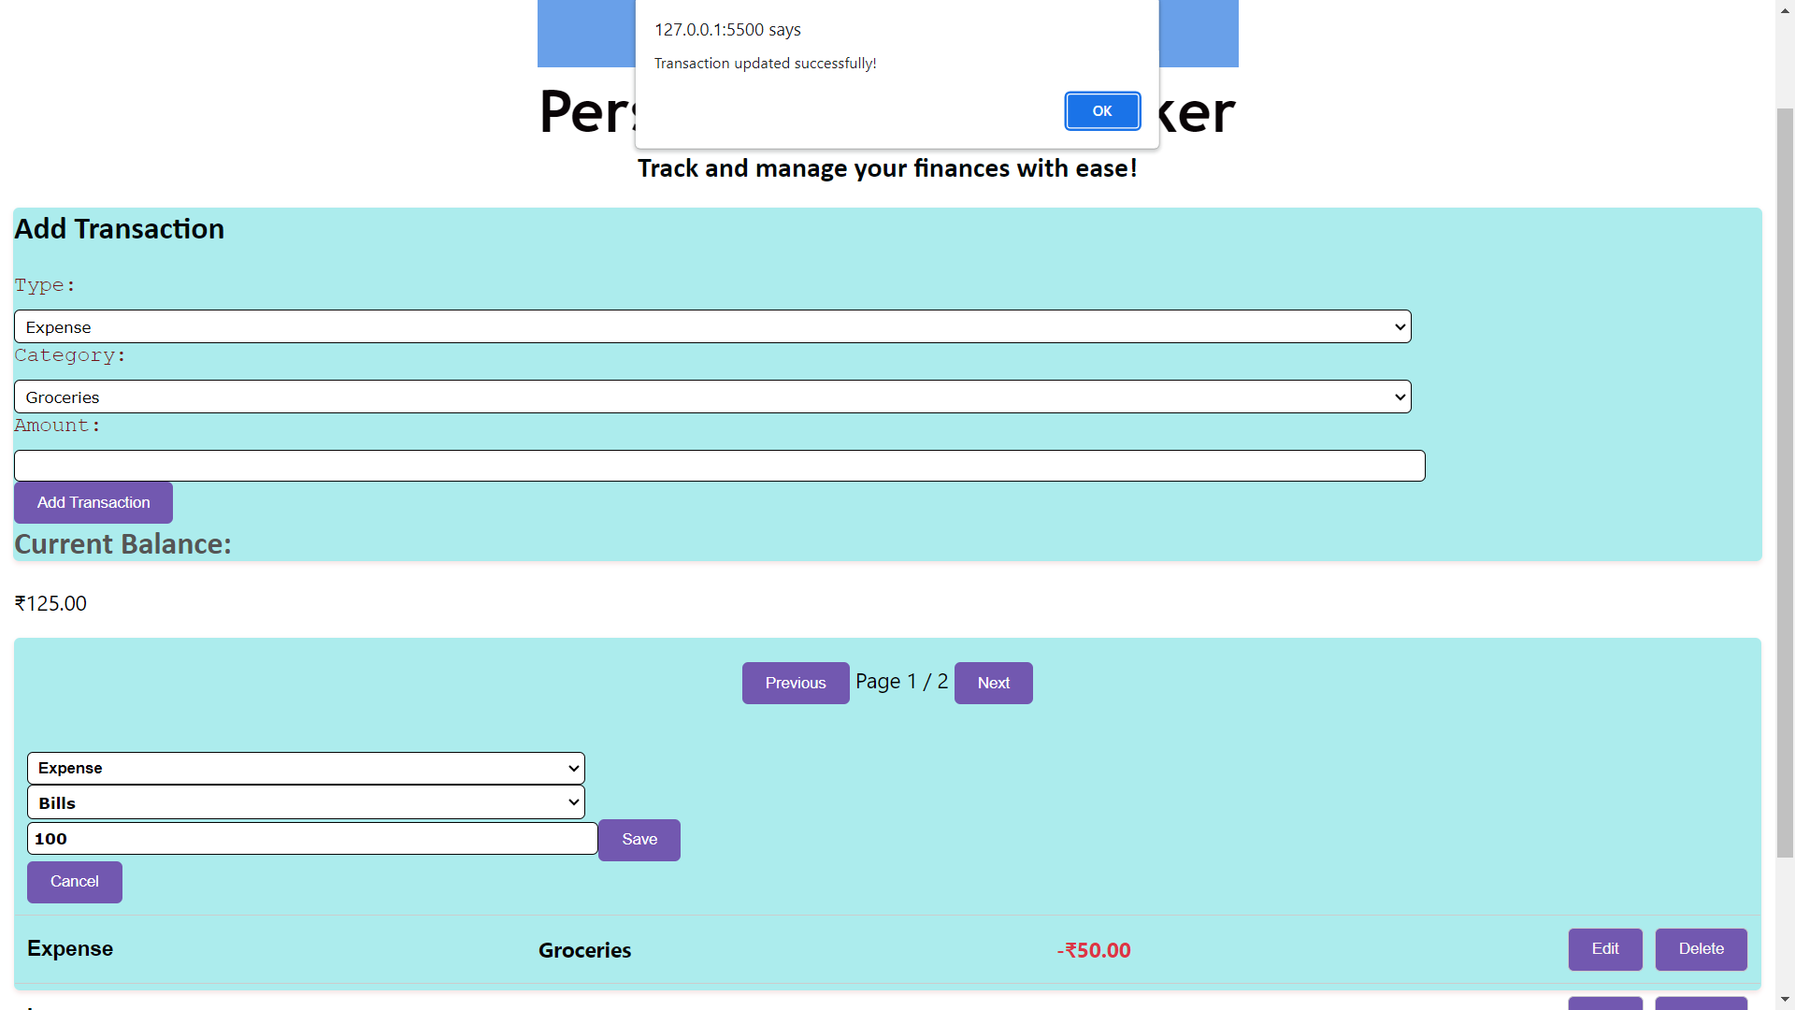
Alert message after transaction update.

Slide 12
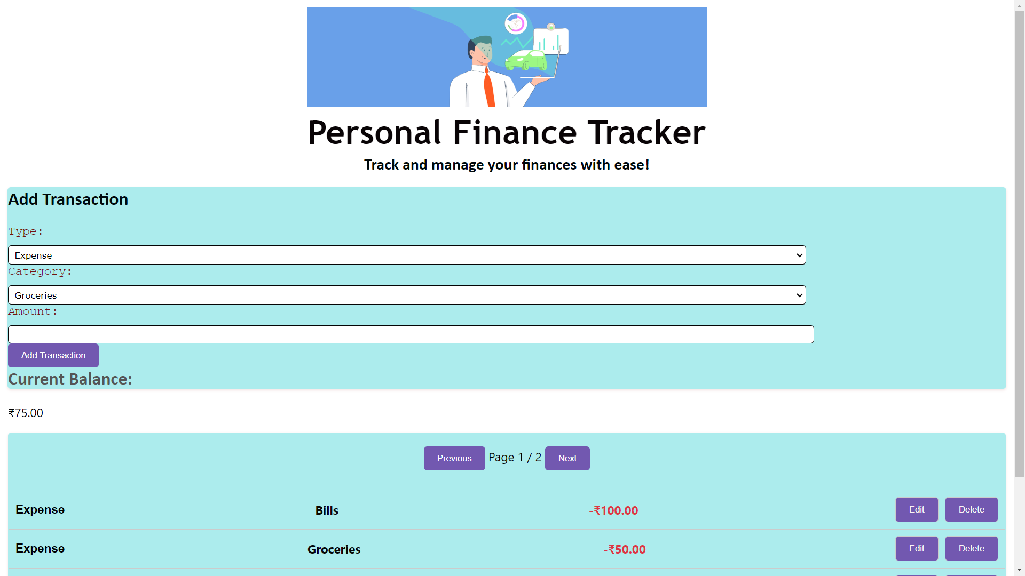
Also the balance has been updated
Transaction updated from Income,Salary to Expense,bills

Slide 13
Deleting Transactions
How users can delete transactions:
Users can delete transactions by clicking on the "Delete" button associated with each transaction in the transaction list.
Upon clicking the "Delete" button, the transaction will be permanently removed from the list.
Delete button functionality and its impact on the balance:
The website provides a delete button for each transaction, allowing users to remove unwanted or incorrect transactions easily.
When a user clicks the "Delete" button, the associated transaction is removed from the transaction list, and the balance is adjusted accordingly.
Deleting an expense transaction increases the balance, while deleting an income transaction decreases the balance.
The website automatically updates the balance after a transaction is deleted, ensuring accurate financial calculations.

Slide 14


Slide 15
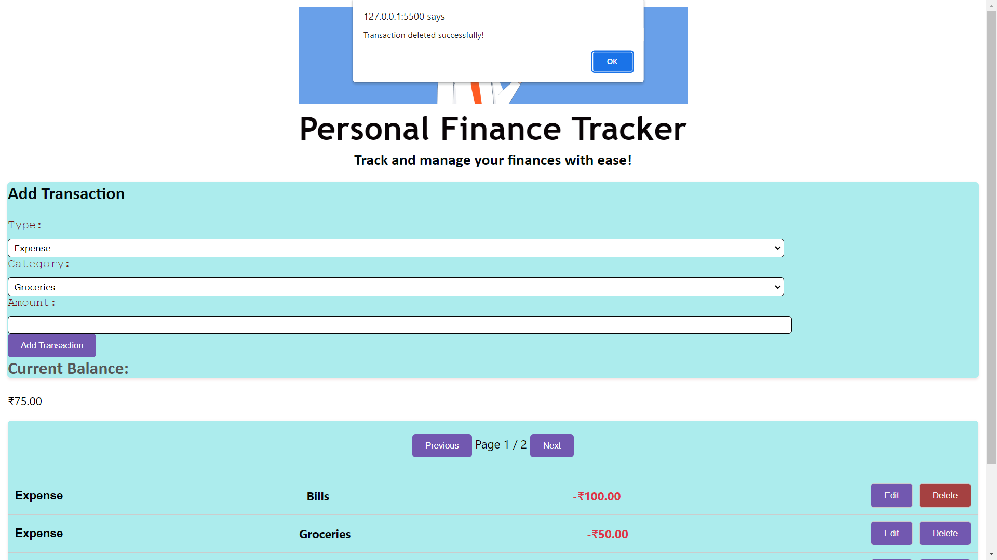

Slide 16
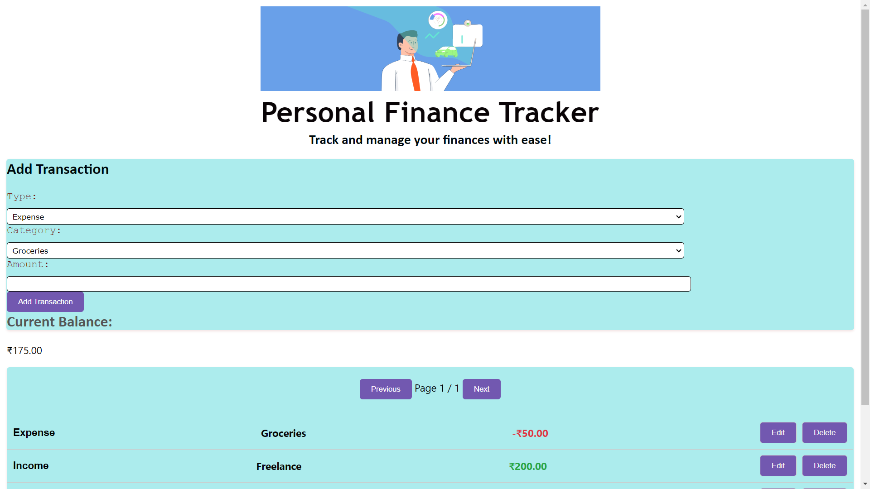
Balance is updated after acknowledgement of alert message.

Slide 17
Pagination
Pagination feature and its benefits:
The website includes a pagination feature to enhance the user experience when browsing through a large number of transactions.
Pagination divides the transactions into multiple pages, with a fixed number of transactions displayed per page.
This feature improves usability by allowing users to navigate through transactions easily and efficiently.
Implementation of pagination in the code:
The code implements pagination through the use of the currentPage variable, which keeps track of the current page being displayed.
The transactionsPerPage variable determines the number of transactions shown per page.
The prevButton and nextButton elements serve as navigation buttons for moving to the previous and next pages, respectively.

Slide 18
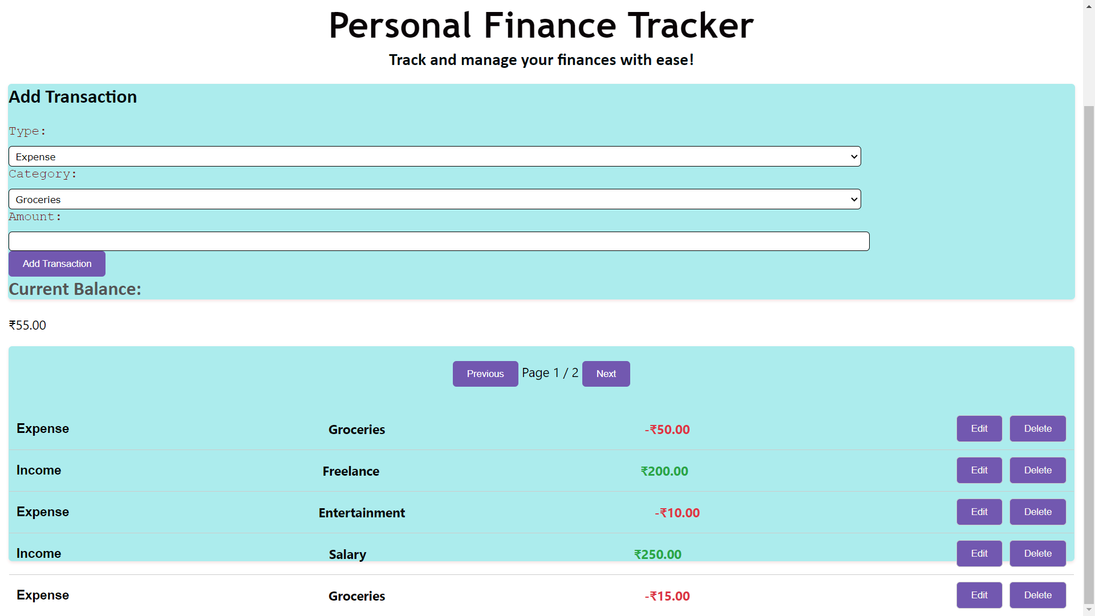

Slide 19
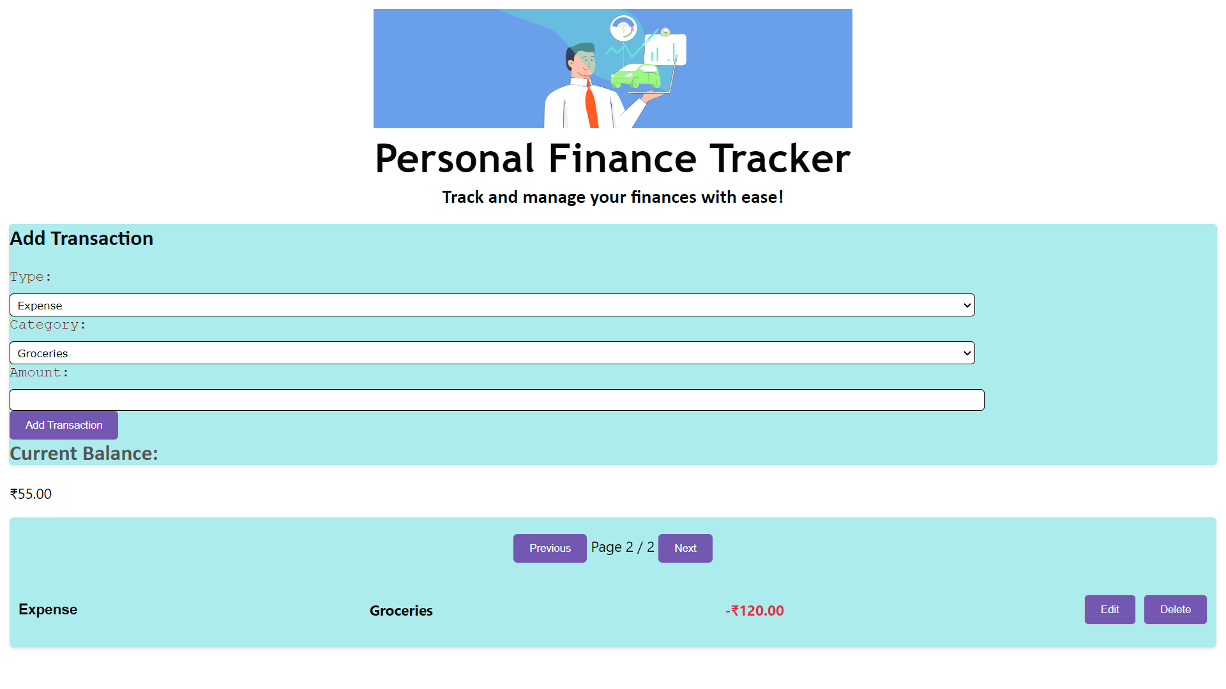

Slide 20
Balance Calculation
Calculation and Update of Balance:
The balance represents the net financial position based on the transactions recorded.
The code maintains a balance variable that stores the current balance value.
The balance is calculated and updated every time a transaction is added, edited, or deleted.
Balance Calculation:
The code tracks the income and expense transactions separately using positive and negative values, respectively.
When a new transaction is added, the transaction's amount is added to the balance if it is an income transaction, or subtracted if it is an expense transaction.
Similarly, when a transaction is edited or deleted, the balance is adjusted accordingly based on the old and new transaction amounts.

Slide 21
3. Significance of Balance:
The balance provides users with a clear picture of their financial situation.
It allows users to monitor their income, expenses, and overall financial health.
Users can quickly determine if they are in a surplus or deficit based on the balance value.
The balance helps in making informed financial decisions and managing budgets effectively.

Slide 22
Conclusion and Future Enhancements
Summary of the Project:
In this project, we have developed a simple web-based expense tracker application.
The application allows users to record their income and expenses, categorize transactions, and view their financial history.
It provides features such as adding, editing, deleting and alert for transactions, as well as pagination for improved user experience.
Achievements and Benefits:
The project successfully implements the core functionality of tracking transactions and maintaining a balance.
Users can easily add, edit, and delete transactions, enabling them to manage their financial records effectively.
The pagination feature enhances the user experience by allowing them to navigate through transactions efficiently.
Future Enhancements:
The project can be further enhanced with additional features and improvements:
Data persistence: Implement a backend or database integration to store transactions persistently.
User authentication: Add user registration and login functionality to secure personal financial data.
Filtering and sorting: Enable users to filter and sort transactions based on categories, dates, or amounts.
Reports and analytics: Provide visual representations and insights into spending patterns and financial trends.
Budgeting tools: Allow users to set budgets, track expenses against budgets, and receive notifications.

